Slide 1
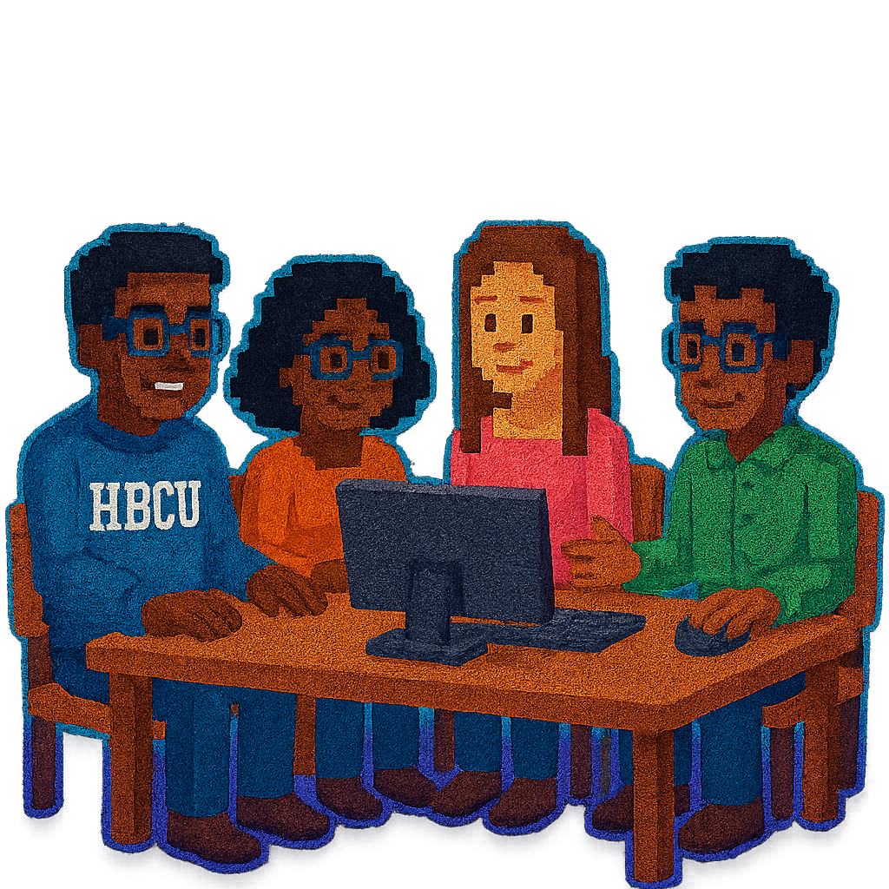
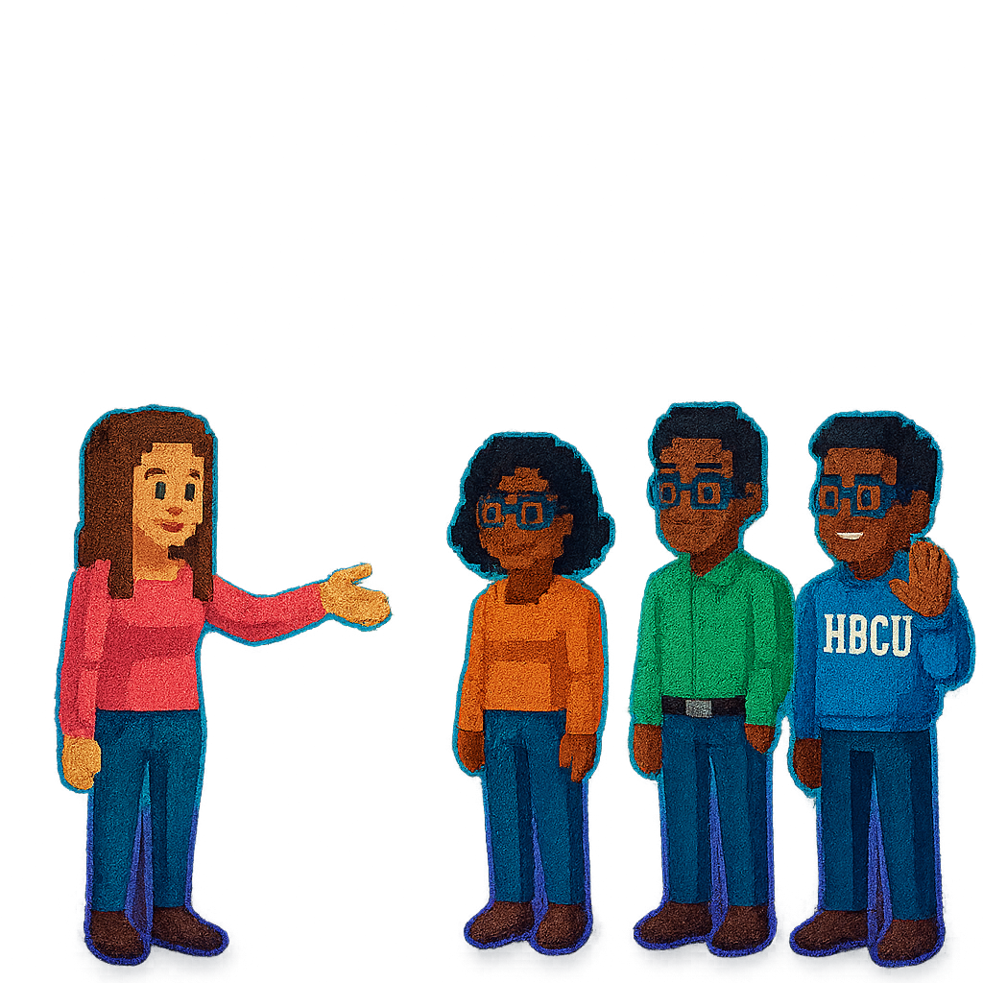
CodeRunners

Slide 2

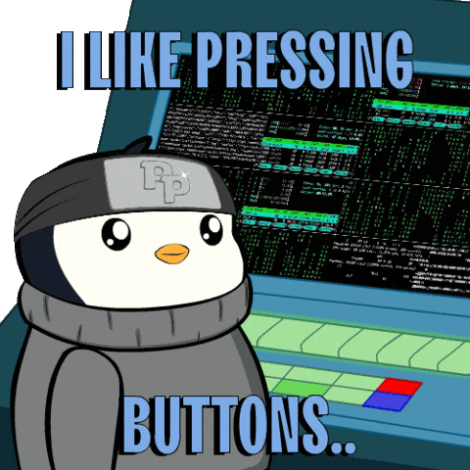
CodeRunners
Team Members Name
Iyana Jones
Arghavan Noori
Aaliyah Lockett
Copernic Mensah
Holy Agyei
https://on.soundcloud.com/u1r553T8KodM05Lj0j

Slide 3







Key Milestones and Deliverables
01
02
03
04
05
Team formation, IEEE paper review, role assignment, GitHub setup with README and project goals.
Deliverables:
Intro slide, README.md, team roles, initial repo push.
Identify code/data, test reproducibility environment, begin small-scale runs.
Deliverables:
Artifact notes, initial tests (e.g., code summarization benchmark), logging results.
Define reproducibility metrics, evaluate 2–3 model-task pairs, log gaps or bugs.
Deliverables:
Reproducibility scorecard (draft), run logs, annotated test outputs.
Website/dashboard
Deliverables:
Streamlit/Flask portal with charts, Poster to display reproducibility analysis and polish poster.
Submit poster, deliver final presentation, and commit all documentation.
Deliverables:
Final poster + presentation deck, updated repo, portal link or local deployment.

Slide 4
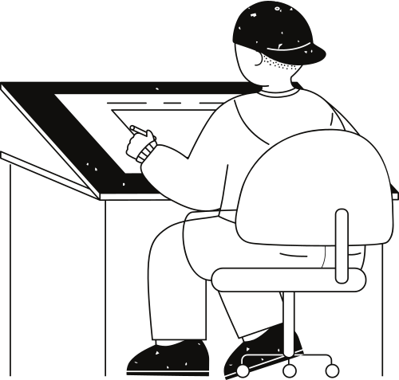


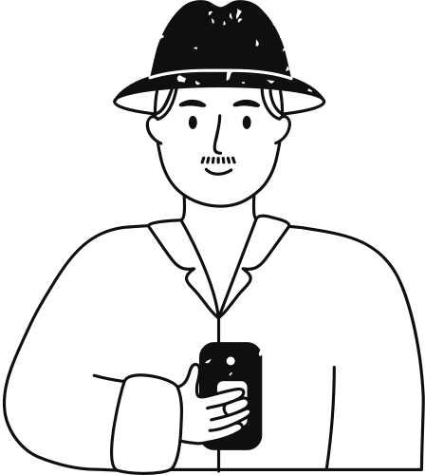



Iyana | Lead
Tracks goals, edits README, manages daily progress, ensures overall project alignment.
Aaliyah | Experiment Engineer
Sets up tasks, configures environments, and runs models for evaluation.
Team Roles
Arghavan | Model Analyst Compares model outputs, analyzes results, and scores reproducibility gaps.
Holy | Portal Builder
Develops the interactive dashboard or website for the reproducibility scorecard and visualizations.
& Responsibilities
Copernic | Presenter
Creates compelling visuals for the poster and presentation slides.
Github
https://github.com/SGX3CodeRunners/RealWorldBugs.git

